Slide 1

Introduction to Law
PARALEGAL TRAINING

Slide 2

Common notions of Law
The law is blind
The law has teeth and will bite
The long arm of the law
The full force of the law

Slide 3
What is Law?
Law provides rules
It tells us what we can and cannot do
This is true in our personal lives (eg criminal law)
And in our business lives (eg contract law)
It is important for a person to know the rules which apply to them

Slide 4
What is Law? (cont.)
Yet, law is more than just rules
Societies require order to allow people to live and deal with each other
Law is a means of creating and maintaining social order
It does this by helping to deal with arguments and conflicts

Slide 5
What is Law? (cont.)
Different countries have different forms of law and social order
We shall be looking at some of the basic principles of law
Many of these principles can be found in different legal systems

Slide 6
Categories of Law
Law is a very large field, and it is common to divide it into categories
common law and civil law
common law and statute law
private law and public law
civil law and criminal law

Slide 7
Common Law and Civil Law
A legal system is the way the law is structured and operated in a country
  Sierra Leone and China have different legal systems
Common Law and Civil Law are terms used to describe legal systems

Slide 8
Common Law
Common Law is used to describe legal systems based on the English legal system
These are usually countries which were once part of the British Empire
  e.g.: Sierra Leone, Ghana, Nigeria

Slide 9
Common Law v. Civil Law
Common Law
Case law and the courts are most important source of law
Civil Law
Consists of a legal code of general principles which is the source of law

Slide 10
Common Law and Statute Law
Common Law is the law and procedures created by courts (i.e. judges)
Statute Law is legislation created by the government
  In Sierra Leone, this is Parliament
  e.g. Child Right Act 2007
  e.g. Public Order Act 1965

Slide 11
Private Law
Private Law deals with the relationships between people in everyday transactions
That includes you, as well as businesses and companies
Private Law includes the law of contract and the law of tort

Slide 12
Public Law
Public Law deals with the relationships between government organisations and ordinary citizens
  also between different government organisations
Public Law includes constitutional law, administrative law, and criminal law

Slide 13
Civil Law
In this category, “civil law” has a different meaning from the Common Law and Civil Law category
In this category, civil law deals with the relationships between individual citizens
Its purpose is to settle arguments between individuals
It helps people to find remedies
  it does not generally punish people, but may demand financial punishments
Civil Law includes all Private and some Public Law

Slide 14
Criminal Law
Criminal Law deals with rules created by the State which forbid certain behaviour
These are “crimes”
Criminal Law punishes people
  it does not provide remedies
Criminal Law is usually what people think of when they think about “The Law”
Criminal Law is part of Public Law

Slide 15
Criminal Law v. Civil Law
A very important difference between criminal law and civil law relates to court cases
In a criminal case, the prosecutors (ie the State) must prove their case beyond reasonable doubt
In a civil case, the parties only have to prove their case on the balance of probabilities

Slide 16
c
Civil Law
Civil law
Private
Law
Public Law
Statute law
Common law
Criminal law

Slide 17
Law and morality
Law, unlike morality, is made by someone
Morality refers to a code of conduct put forward by a society or group or accepted by an individual
Should law have certain distinctive moral aims?
If it lacks those aims should it be called law?

Slide 18
Role of law in society
Maintain law and order
Regulate individual relationships - domestic
Regulate business relationships - companies
Protection of interests
Protection of rights
Limiting the power of the state
Providing scope for good government

Slide 19
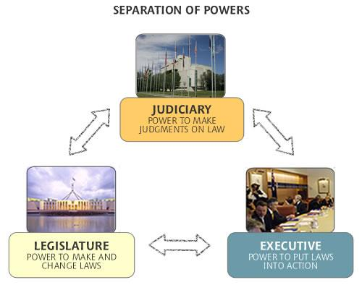
Law making, implementation and interpretation

Slide 20
The End
Questions?

